Slide 1
Software Project Management Plan
Chapter 4
LOC & Function Point Analysis

Slide 2
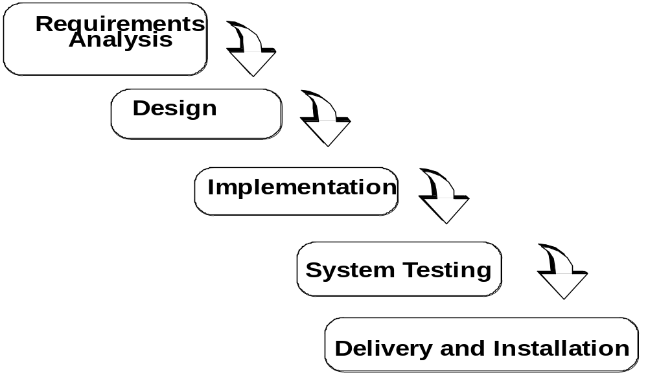
How it should go

Slide 3
Software Project Management Plan
Software Project:
  All technical and managerial activities required to deliver to the client.
  A software project has a specific duration, consumes resources and produces work products.
  Management categories to complete a software project:
    Tasks, Activities, Functions
Software Project Management Plan:
  The controlling document for a software project.
  Specifies the technical and managerial approaches to develop the software product.
  Companion document to requirements analysis document: Changes in either may imply changes in the other document.
  SPMP part of project agreement.
Notes:
Tthe central notion of project management is the software project. It defines the technical and managerial activities to develop a product and deliver it to the client.
The central part of the managerial activities is the software project management plan.
A project consists of activities, tasks, and functions.

Slide 4
Project Agreement
Document written for a client that defines:
  the scope, duration, cost and deliverables for the project.
  the exact items, quantities, delivery dates, delivery location.
Can be a contract, a statement of work, a business plan, or a project charter.
Client: Individual or organization that specifies the requirements and accepts the project deliverables.
Deliverables (= Work Products that will be delivered to the client):
  Documents
  Demonstrations of function
  Demonstration of nonfunctional requirements
  Demonstrations of subsystems

Slide 5
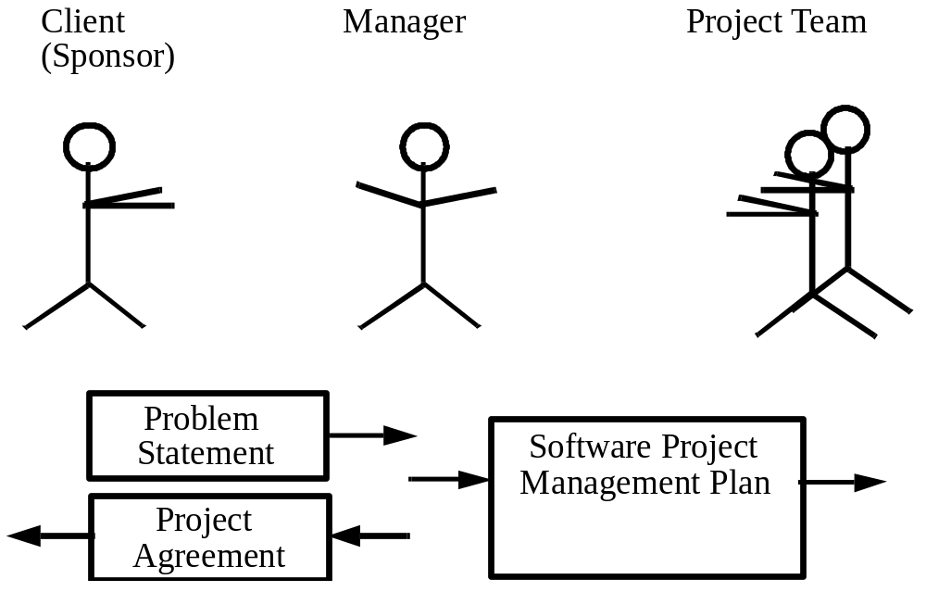
Project Agreement vs Problem Statement

Slide 6
Software Project Planning
After the finalization of Software Requirment Spsefication (SRS), we would like to estimate size, cost and development time of the project. Also, in many cases, customer may like to know the cost and development time even prior to finalization of the SRS.
In order to conduct a successful software project, we must nderstand:
  Scope of work to be done
  Software Project Planning
  The risk to be incurred
  The resources required
  The task to be accomplished
  The cost to be expended
  The schedule to be followed

Slide 7
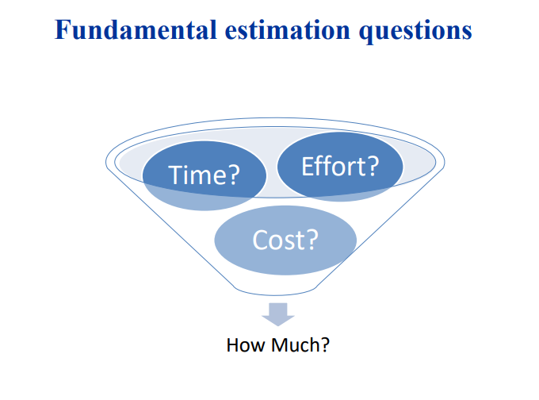
Software Project Planning

Slide 8
Software Project Planning
Fundamental estimation questions
  • How much effort is required to complete an activity?
  • How much calendar time is needed to complete an activity?
  • What is the total cost of an activity?
  • Project estimation and scheduling are interleaved management activities
Software Project Estimation Effort Estimation
  It Is the process of predicting Effort, productivity, time and cost required to develop software projects.
  It uses Software metrics to estimate size of projects
  Software Metrics refers to measurements relating to computer software

Slide 9
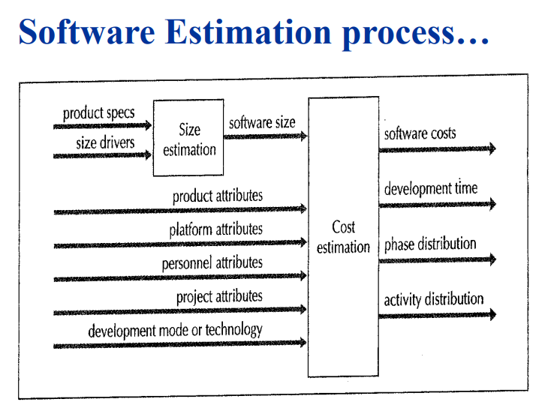
Software Project Planning

Slide 10
Software Project Planning
Software Effort Estimation
  • It Is the process of predicting Effort, productivity, time and cost required to develop software projects.
  • Effort can be calculated as Staff or Person per day/Week/Month/Year.
  • For small project it is common to use Staff / Weeks while for large project it is common to use Staff-months

Slide 11
Software Project Planning
The four basic steps in software project estimation are:
  1) Estimate the size of the development product.
    This generally ends up in either Lines of Code (LOC) , Function Points (FP), or Constrictive Cost Model (COCOMO)
  2) Estimate the effort in person/months or person/hours.
  3) Estimate the schedule in calendar months.
  4) Estimate the project cost in dollars (or local currency)

Slide 12
Software Project Planning
Effort
  • Effort can be calculated as Staff or Person per day/Week/Month/Year
  • For small project it is common to use Staff-Weeks while for large project it is common to use Staff-months
  • Example 30 staff-month means that you need 30 staff to finish it in one month
  • For two months you need only 15 staff per month (30/2) you have more time so you need less people
  • To calculate staff-month in weeks you need to multiply by 4 30*4 = 120 staff-week; to calculated in years /12 (30/12= 2.5 staff-year)
  • To calculate effort phase percentage (e.g. 10% of total effort) 10% of 30 = 3 staff-month. If for example the phase last for 3 months then you need 1 staff for each month 3/3)

Slide 13
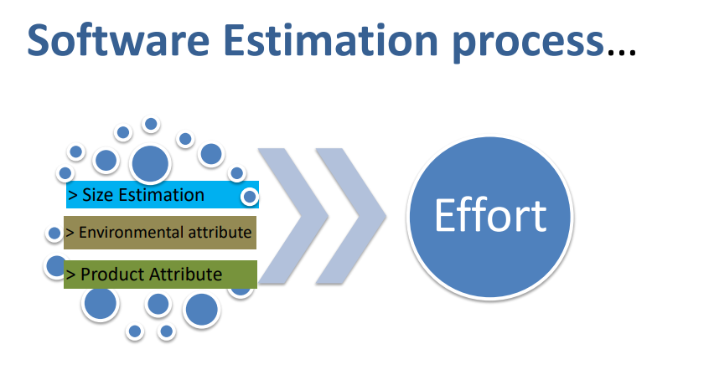
Software Project Planning

Slide 14
Software Project Planning
Bottom-up and top-down Estamation
  • Bottom-up
    – use when no past project data (from scratch)
    – identify all tasks that have to be done – so quite time-consuming
    – use when you have no data about similar past projects
  • Top-down
    – produce overall estimate based on project cost drivers
    – based on past project data
    – divide overall estimate between jobs to be done

Slide 15
Software Project Planning
Bottom-up estimating
  1. Break project into smaller and smaller components
  2. Stop when you get to what one person can do in one/two weeks
  3. Estimate costs for the lowest level activities
  4. At each higher level calculate estimate by adding estimates for lower levels

Slide 16
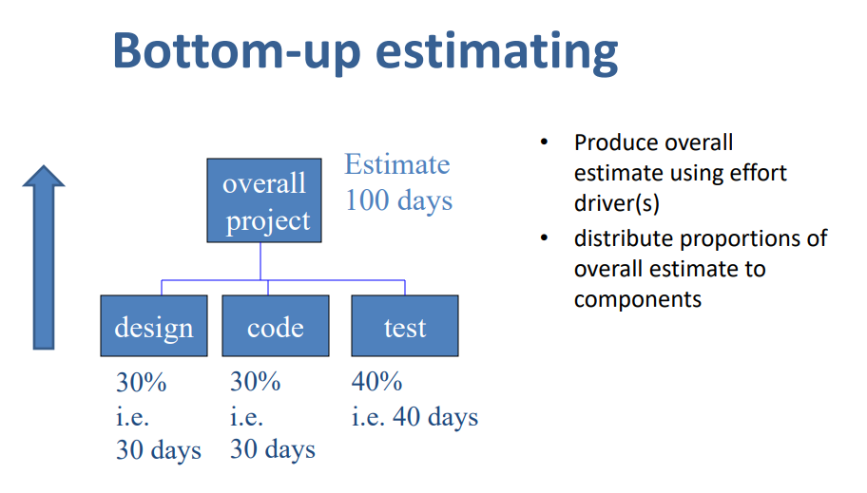
Software Project Planning

Slide 17
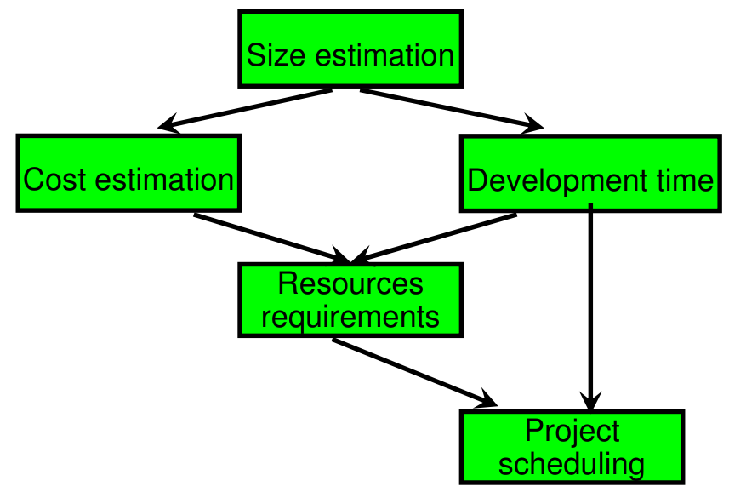
Software Project Planning
Activities during Software Project Planning

Slide 18
Software Project Planning
Source Line of Code (LOC)
  • LOC = NCLOC + CLOC
  – NCLOC : non- commented Line of code.
  – CLOC :commented Line of code.
  • KLOC is used to denote thousands of Line of code.
  • Blank lines - not usually counted
Example
  for (i = 0; i < 100; i++); printf("hello"); /* How many lines of code is this? */
  In this example we have:
    • 1 Physical Line of Code (LOC)
    • 2 Logical Lines of Code (LLOC) (for statement and printf statement)
    • 1 comment line

Slide 19
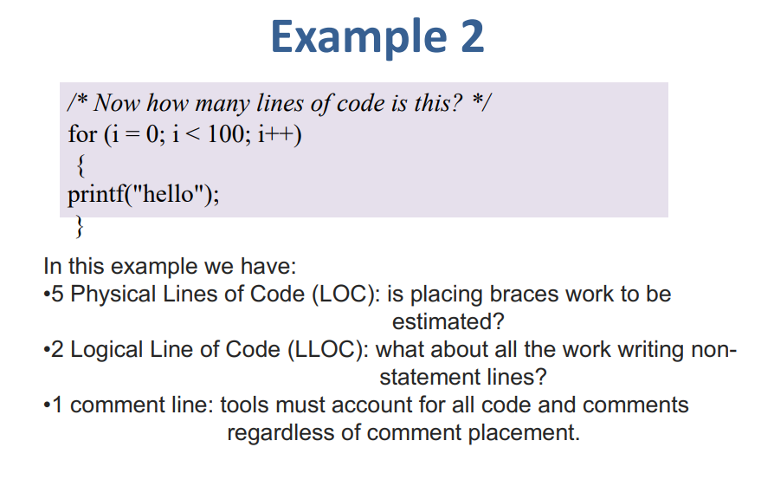

Software Project Planning

Slide 20
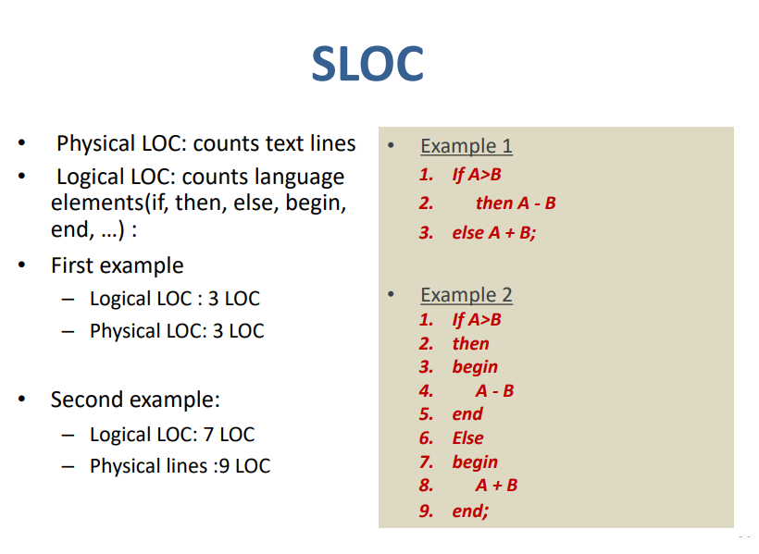
Software Project Planning

Slide 21
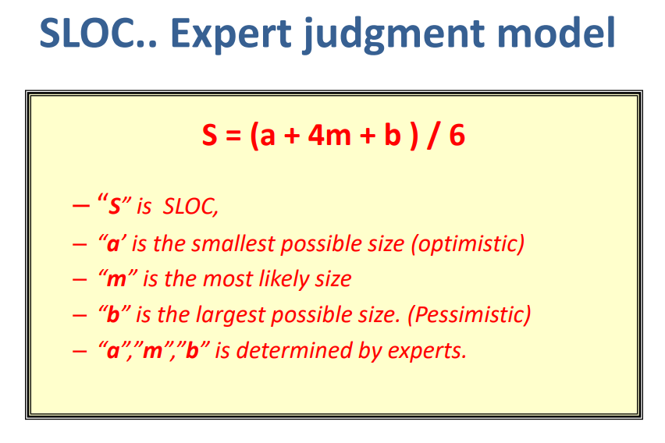
Software Project Planning

Slide 22
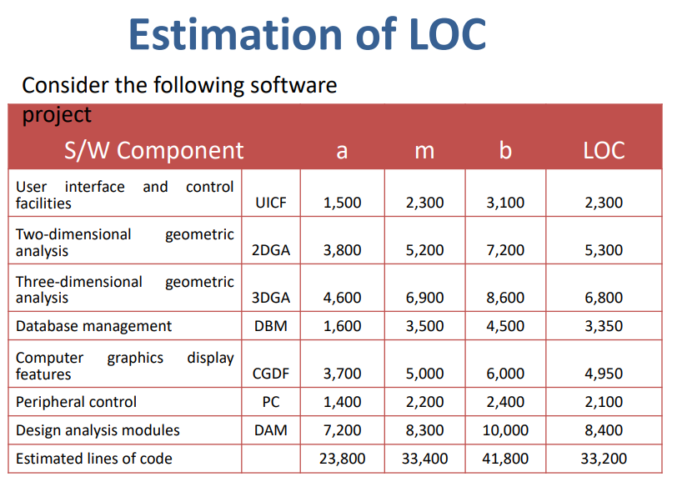
Software Project Planning

Slide 23
Software Project Planning
Example:
  Assume estimated lines of code of a system is: 33,200 LOC, Average productivity for system of this type is: 620 LOC/person-month, there are 6 developers, and labor rate is: $ 800 per person-month . Calculate the total effort and cost required to complete the above project.
  Solution
    => Total Effort = Total LOC/Productivity = 33200/620=53.54 ≈ 54 person-months
    => 6 developers Effort = Total Effort/6 = 54/6 = 9 months
    => Total Cost = Total Effort * Labor Rate = 54 * 800 ≈ $43,200,
    OR Total Cost = Effort * Labor Rate * No of developers = 9 * 6 * 800 ≈ $43,200,

Slide 24
Software Project Planning
Translate the number of LOC to assembly (Compiler) language line in order to make comparisons between programming languages
  e.g.
  convert 50,000 LOC system written in C to Java, Assembler level for C = 2.5, Java = 6
  50,000 * 2.5 = 125,000 if written in assembler
  125,000 / 6 = 20,833 LOC if written in Java

Slide 25
Software Project Planning
Function Count
  Alan while working for IBM, recognized the problem in size measurement in the 1970s, and developed a technique (which he called Function Point Analysis), which appeared to be a solution to the size measurement problem
  The principle of function point analysis (FPA) is that a system is decomposed into functional units
    Inputs : information entering the system
    Outputs : information leaving the system
    Enquiries : requests for instant access to information
    Internal logical files : information held within the system
    External interface files : information held by other system that is used by the system being analyzed

Slide 26
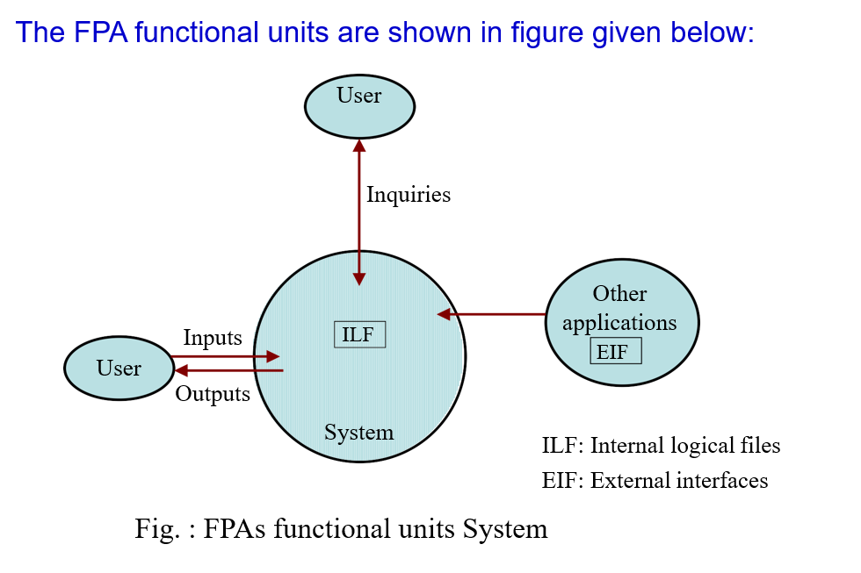

Slide 27
Software Project Planning
The five functional units are divided in two categories:
(i) Data function types
  Internal Logical Files (ILF):
    A user identifiable group of logical related data or control information maintained within the system
  External Interface files (EIF):
    A user identifiable group of logically related data or control information referenced by the system, but maintained within another system. This means that EIF counted for one system, may be an ILF in another system.
(ii) Transactional function types
  External Input (EI):
    An EI processes data or control information that comes from outside the system. The EI is an elementary process, which is the smallest unit of activity that is meaningful to the end user in the business.
  External Output (EO):
    An EO is an elementary process that generate data or control information to be sent outside the system.
External Inquiry (EQ): An EQ is an elementary process that is
made up to an input-output combination that results in data
retrieval

Slide 28
Software Project Planning
  External Output (EO):
    An EO is an elementary process that generate data or control information to be sent outside the system.
  External Inquiry (EQ):
    An EQ is an elementary process that is made up to an input-output combination that results in data retrieval

Slide 29
Software Project Planning
Special features
  Function point approach is independent of the language, tools, or methodologies used for implementation; i.e. they do not take into consideration programming languages, data base management systems, processing hardware or any other data base technology
  Function points can be estimated from requirement specification or design specification, thus making it possible to estimate development efforts in early phases of development
  Function points are directly linked to the statement of requirements; any change of requirements can easily be followed by a re-estimate
  Function points are based on the system user’s external view of the system, non-technical users of the software system have a better understanding of what function points are measuring

Slide 30
Counting function points
Functional Units | Weighting factors
 | Low | Average | High
External Inputs (EI) | 3 | 4 | 6
External Output (EO) | 4 | 5 | 7
External Inquiries (EQ) | 3 | 4 | 6
External logical files (ILF) | 7 | 10 | 15
External Interface files (EIF) | 5 | 7 | 10
Table 1 : Functional units with weighting factors

Slide 31
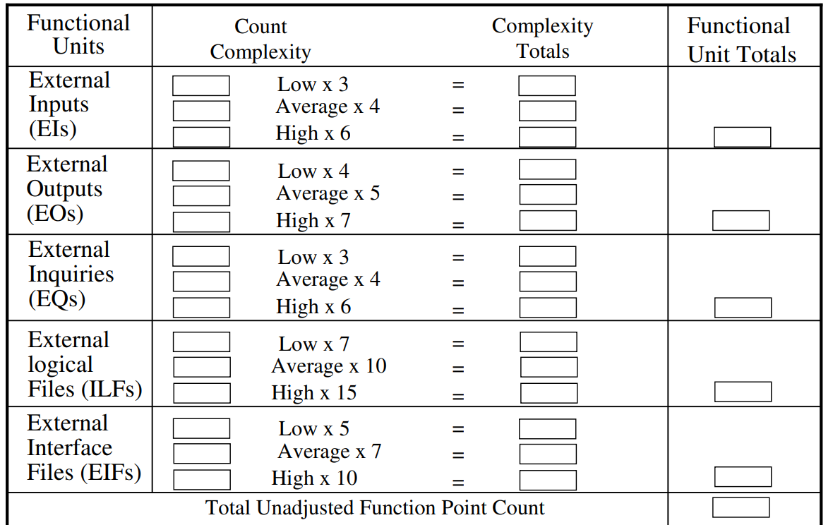

Slide 32
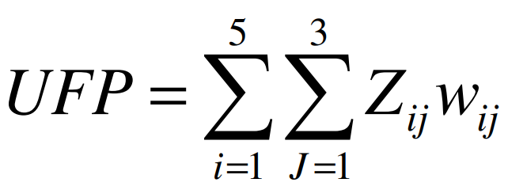
Software Project Planning
The weighting factors are identified for all functional units and multiplied with the functional units accordingly. The procedure for the calculation of Unadjusted Function Point (UFP) is given in table shown previous slide.
The procedure for the calculation of UFP in mathematical form is given below
Where i indicate the row and j indicates the column of Table 1 W_{ij} : It is the entry of the ith row and jth column of the table 1 Z_{ij} : It is the count of the number of functional units of Type i that have been classified as having the complexity corresponding to column j.

Slide 33

Software Project Planning
Where CAF is Complexity Adjustment Factor and is equal to [0.65 + 0.01 x ΣFi]. The Fi (i=1 to 14) are the degree of influence and are based on responses to questions noted in table 3

Slide 34
Table 3 : Computing function points.
Rate each factor on a scale of 0 to 5.
2 3
4
5
Average
No Influence
Incidental Moderate Significant Essential
Number of factors considered ( F_{i} )
Does the system require reliable backup and recovery ? (backup and recovery )
Is data communication required ? (Data communications)
Are there distributed processing functions ? (Distributed data processing)
Is performance critical ? (Performance)
Will the system run in an existing heavily utilized operational environment ? (Transaction rate)
Does the system require on line data entry ? (On-line data entry)
Does the on line data entry require the input transaction to be built over multiple screens or operations ? (Multiple sites)
Are the master files updated on line ? (On-line update)
Is the inputs, outputs, files, or inquiries complex ? (Complex processing)
Is the internal processing complex ? (Operational ease)
Is the code designed to be reusable ? (Reusability)
Are conversion and installation included in the design ? (Heavily used configuration)
Is the system designed for multiple installations in different organizations ? (Installation ease)
Is the application designed to facilitate change and ease of use by the user ? ((Facilitate change)

Slide 35
Software Project Planning
Functions points may compute the following important metrics:
  Productivity = FP / persons-months
  Quality = Defects / FP
  Cost = / FP
  Documentation = Pages of documentation per FP
There are standards issued by the International Functions Point User Group (IFPUG), covering the Albrecht method and the United Kingdom Function Point User Group (UFPGU), covering the MK11 method
An ISO (International Organization for Standardization) standard for function point method is also being developed

Slide 36
Software Project Planning
Example:
Consider a project with the following functional units:
  Number of user inputs = 50
  Number of user outputs = 40
  Number of user enquiries = 35
  Number of user files = 06
  Number of external interfaces = 04
Assume all complexity adjustment factors and weighting factors are average. Compute the function points for the project.

Slide 37
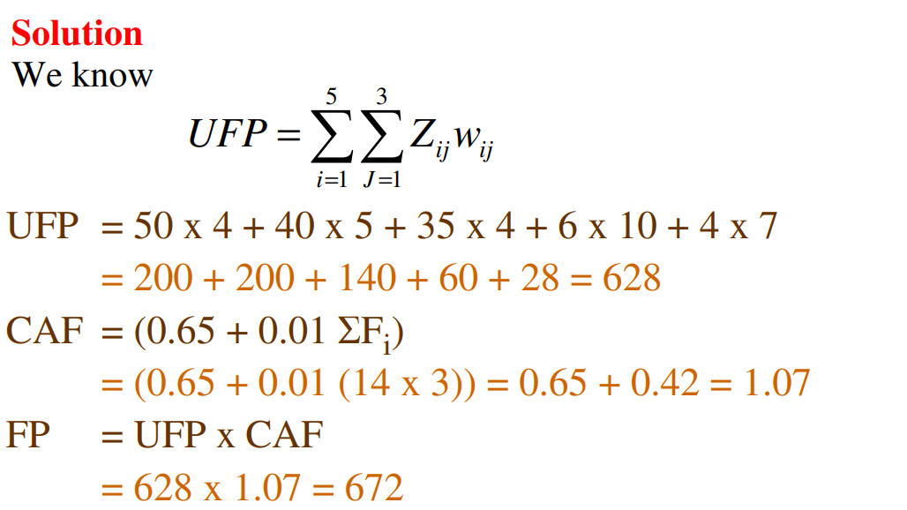

Slide 38
Software Project Planning
Example: An application has the following:
  10 low external inputs, 12 high external outputs, 20 low internal logical files, 15 high external interface files, 12 average external inquiries, and a value of complexity adjustment factor of 1.10.
What are the unadjusted and adjusted function point count

Slide 39
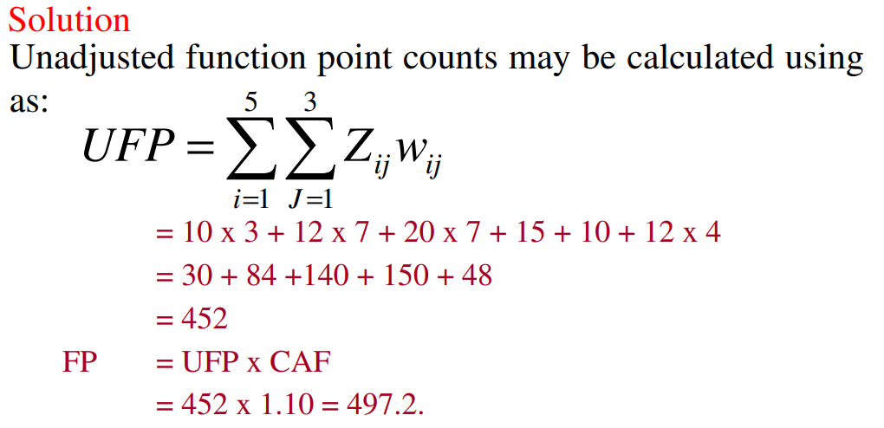

Slide 40
Software Project Planning
Example: Consider a project with the following parameters.
  (i) External Inputs:
    (a)10 with low complexity (b)15 with average complexity (c)17 with high complexity
  (ii) External Outputs:
    (a) 6 with low complexity (b)13 with high complexity
  (iii) External Inquiries:
    (a) 3 with low complexity (b) 4 with average complexity (c) 2 high complexity
  (iv) Internal logical files:
    (a)2 with average complexity (b)1 with high complexity
  (v) External Interface files:
    (a)9 with low complexity
  In addition to above, system requires
    i. Significant data communication ii. Performance is very critical iii. Designed code may be moderately reusable iv. System is not designed for multiple installation in different organizations.
    Other complexity adjustment factors are treated as average.
  Compute the function points for the project.

Slide 41
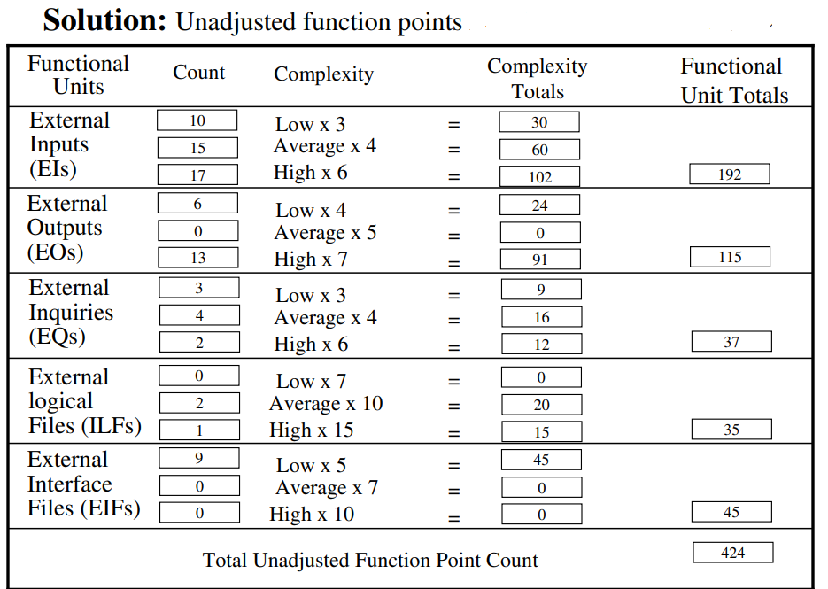

Slide 42
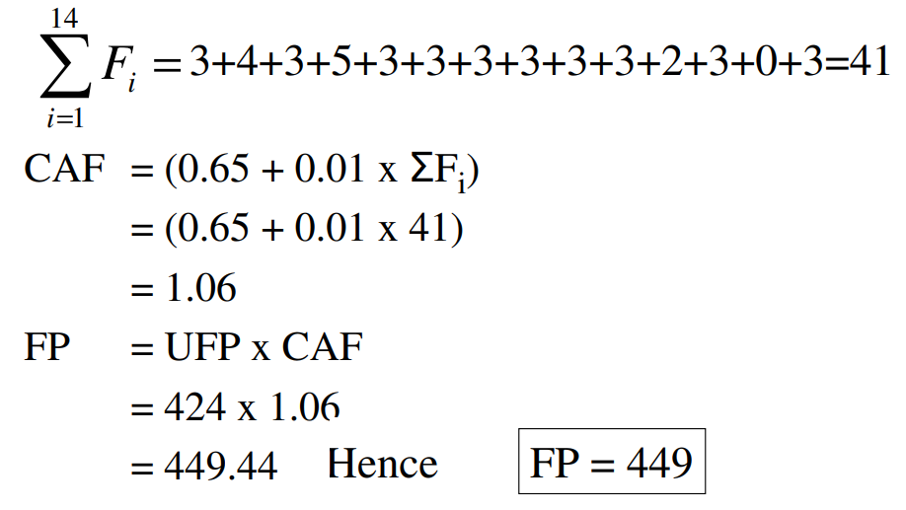

Slide 43
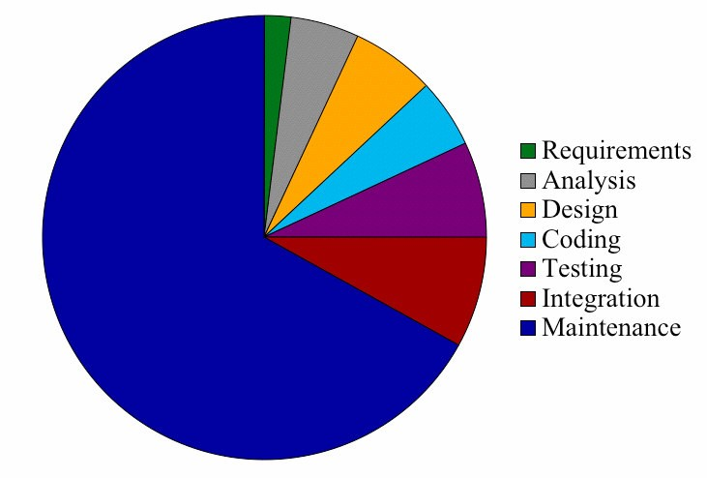
Relative Cost of Software Phases

Slide 44
Functions points may compute the following important metrics:
Avg productivity is → 6.5 FP per person-month
(i.e. 1 person works for 1 month – to develop 6.5 FP)
Avg labor cost is → $6000 / month
A project was estimated at 672 Function points
Cost per function point = 6000/6.5 = $923 per function point
Total estimated project cost = $923 * 672 FP = 6,20,256
Total estimated effort = (672 / 6.5) = 103 person / month.
i.e. 103 person will work for 1 month to complete the project.
Or 52 person will work for 2 months to complete the project.
Or 26 person will work for 4 months to complete the project.
Or 13 person will work for 8 months to complete the project.

Slide 45
A project was estimated at 352 Function points. A four person team will be assigned to this project consisting of an architect, two programmers, and a tester. The burdened labor rate of the architect is $8,000 per month, the programmers $6,000 and the tester $5,000. The average productivity for the team is 8 FP per person month. Compute projected cost.

Slide 46
Calculate number of months
Function points | 352
No of function points team can complete in one month | 32 | (4 people X 8 FPs)
No of months needed to complete | 11
Calculate cost per month
Architect | 8000 | 1 | $8,000
Programmers | 6000 | 2 | $12,000
Tester | 5000 | 1 | $5,000
Cost per month |  |  | $25,000
Total cost (Multiple # of months X Cost per month) |  |  | $275,000

Slide 47
End of Presentation

